Slide 1
Wildfires and public health – the importance of dispersion modelling
Andrew Kibble
Environmental Hazards and Emergencies Department
UKHSA Radiation, Chemicals and Environmental Hazards

Slide 2
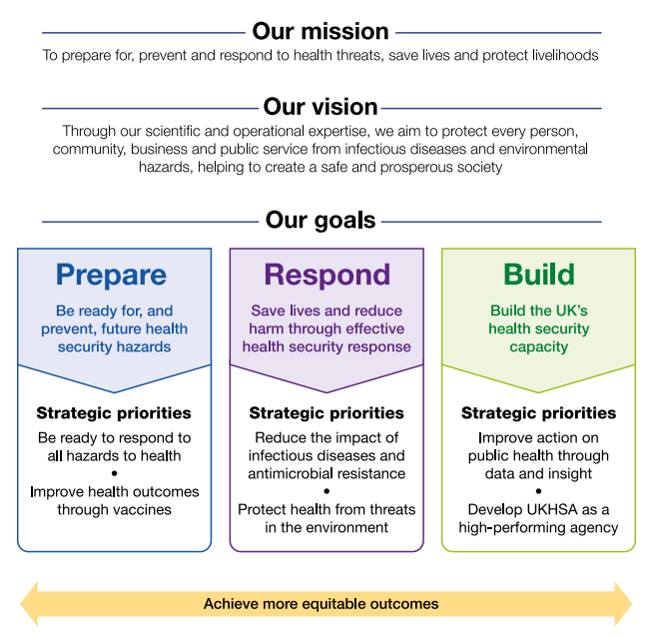
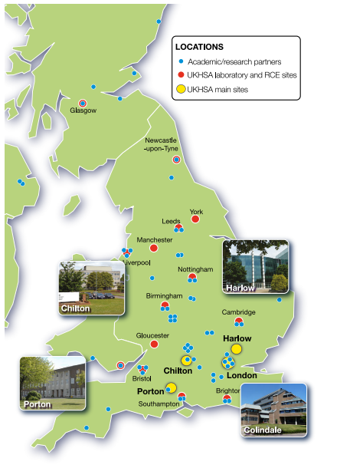
UK Health Security Agency

Slide 3
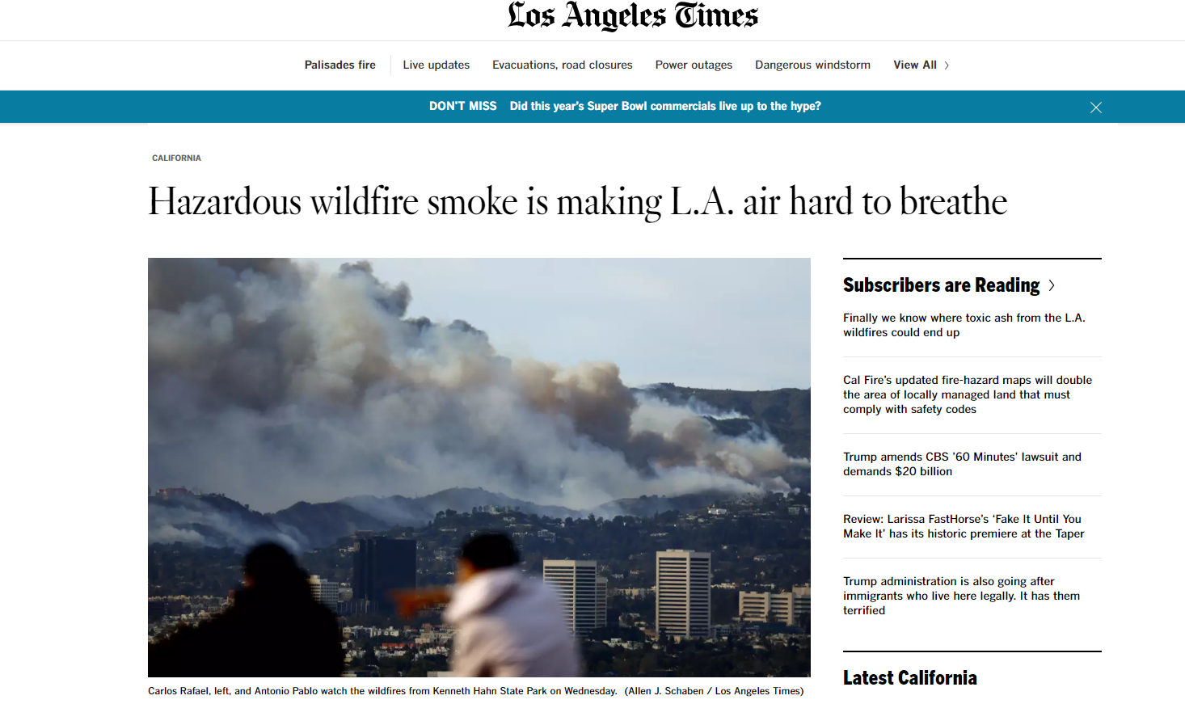
An air monitoring station in downtown Los Angeles recorded a max hourly level of fine particulate pollution of 483.7 ug/m3
USA air quality standard (daily) is 35 ug/m3

Slide 4
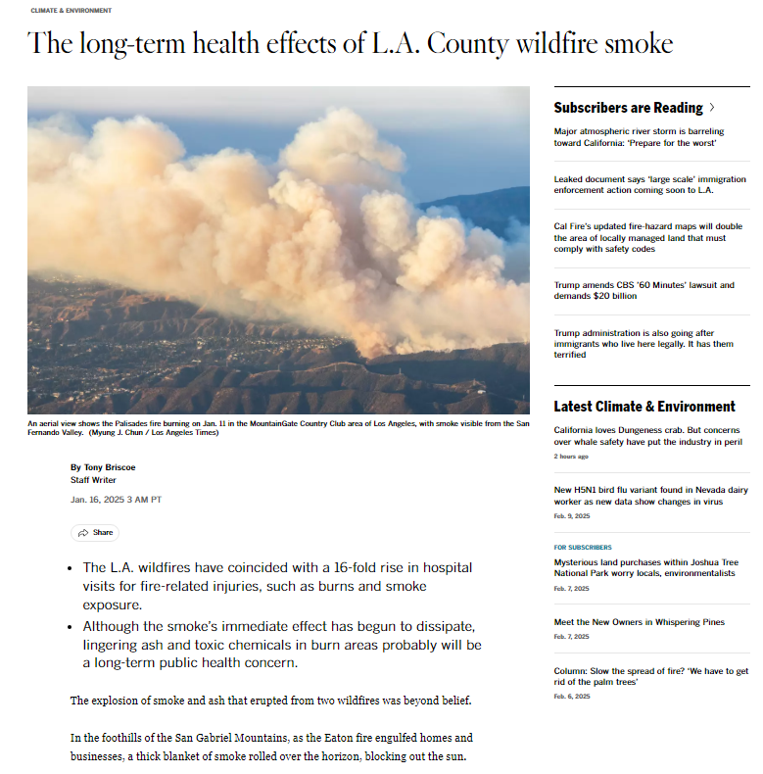
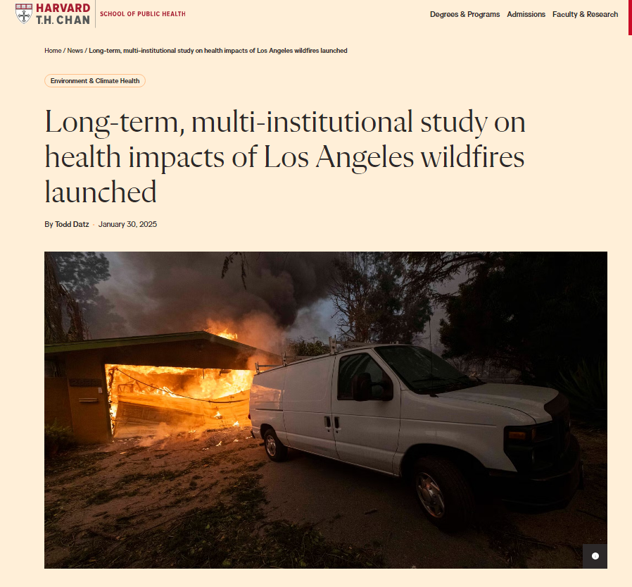
Understanding and measuring exposure is key to any study

Slide 5
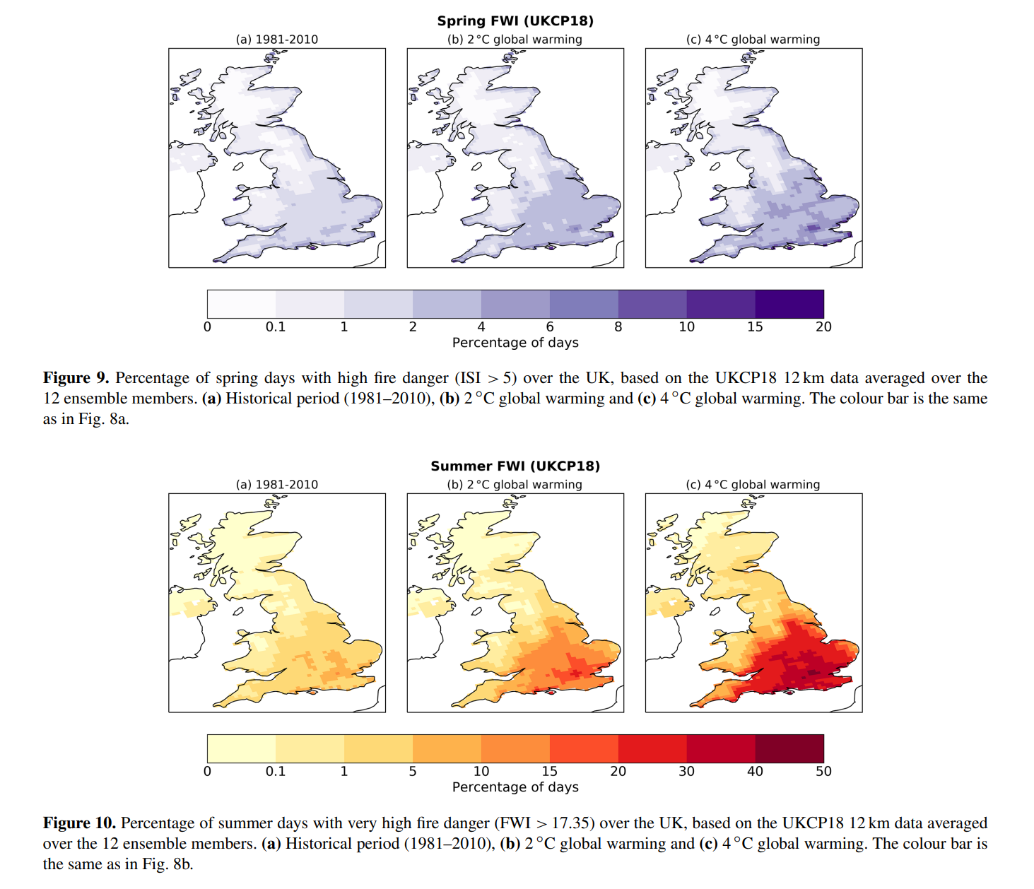
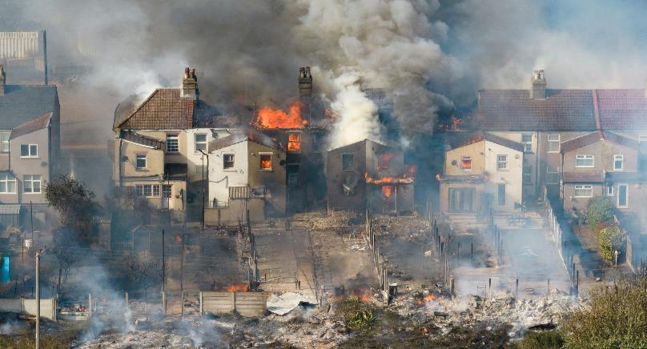
Are wildfires something we should be concerned about in the UK…
UK (currently) does not get the large wildfires we see in other countries
However, we do have a wildfire issue
Many small wildfires, close to people’s homes (the urban/rural interface)
Climate change may increase the problem
A row of houses on fire in the village of Wennington, Essex 2022 © Peter Macdiarmid/LNP

Slide 6
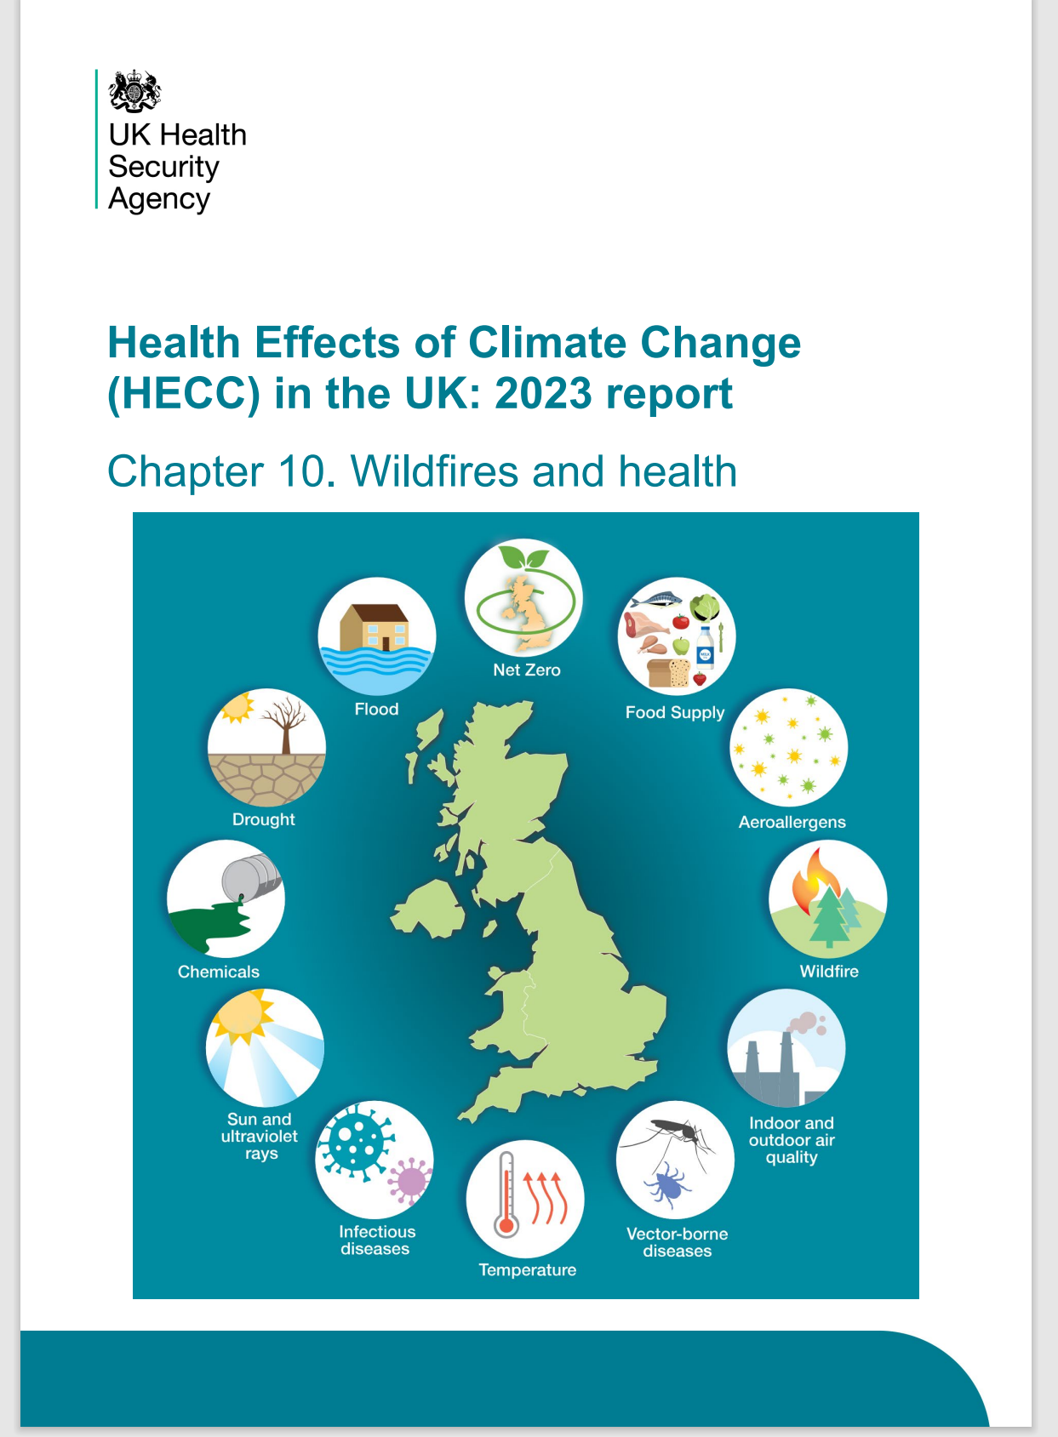
Potential public health impacts
Injuries
Air pollution (wildfire smoke)
Mental health and community resilience
Impact on water quality
Impact of soil quality and stability
Floods and landslides
Co-exposures (heat, drought, ozone)

Slide 7
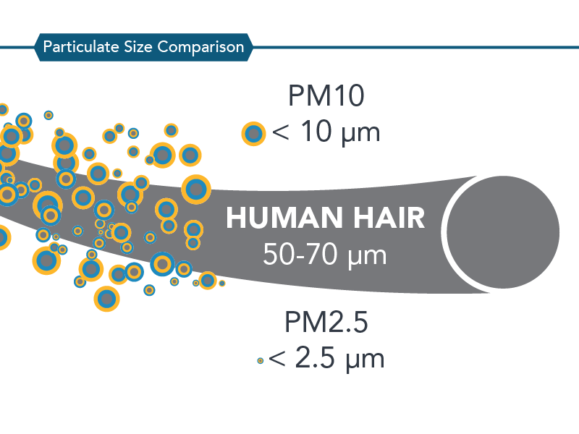
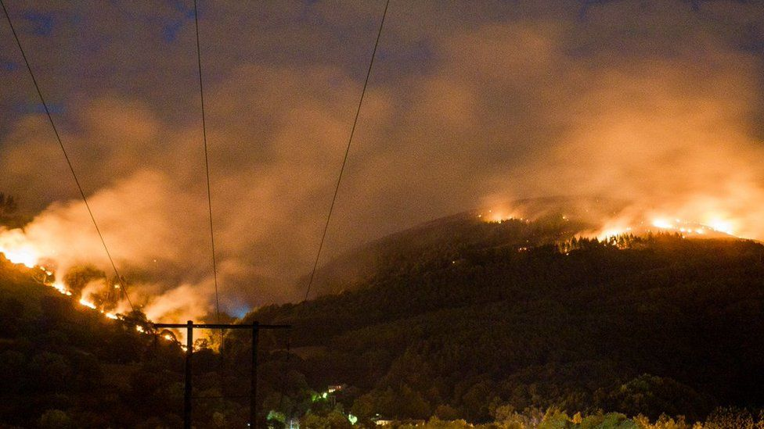
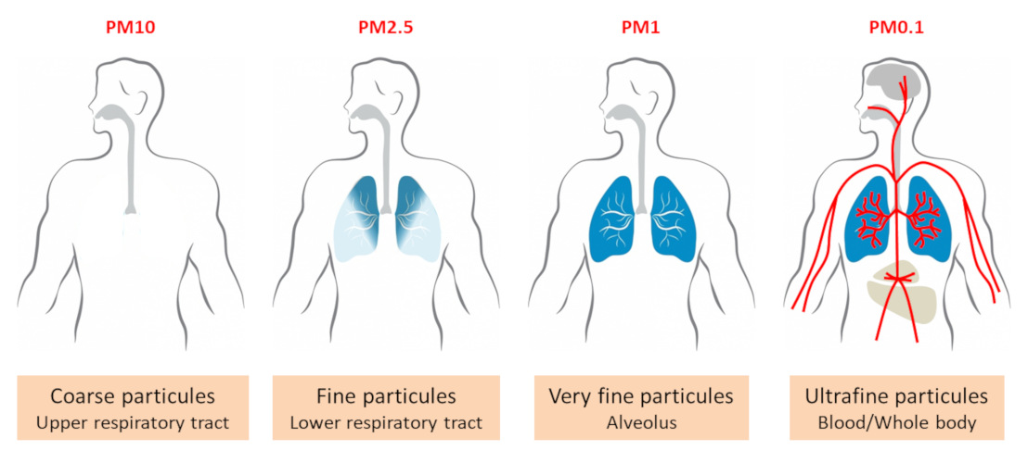
What is in wildfire smoke?
Particles
Toxic gases
Ozone
Bacteria and fungi
CO2 / greenhouse gases
Metals, asbestos from building materials

Slide 8
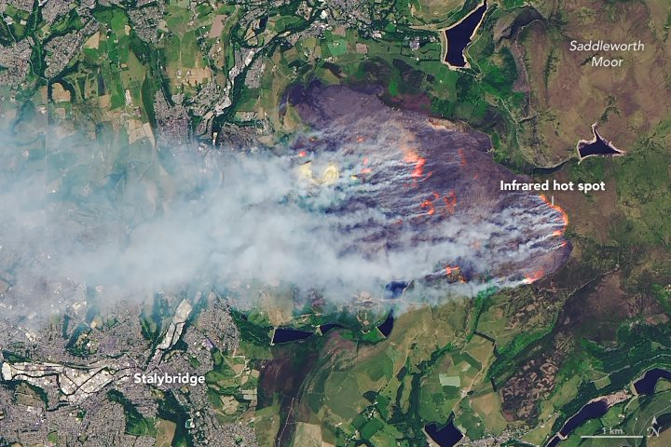
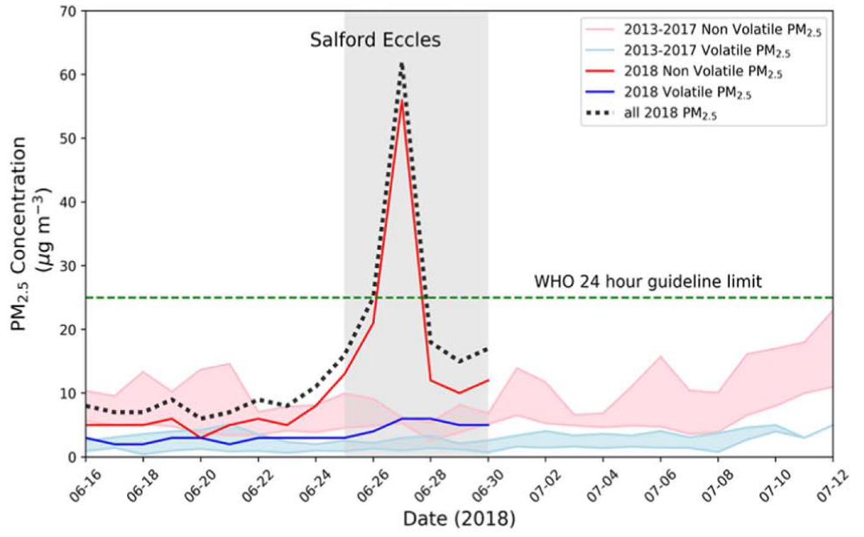
Saddleworth moor fires (June 2018)
View of the Saddleworth Moor fire on 27 June, taken by NASA's Landsat 8 satellite

Slide 9
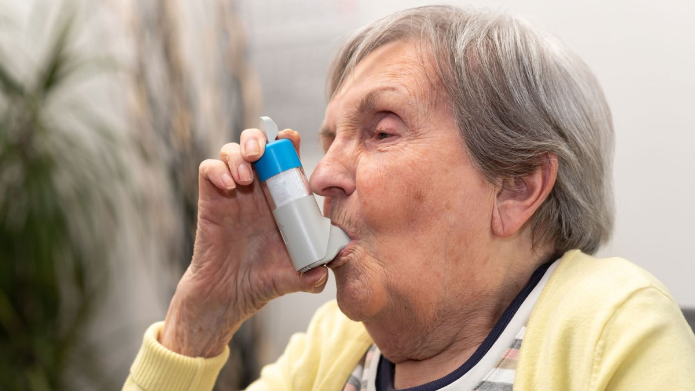
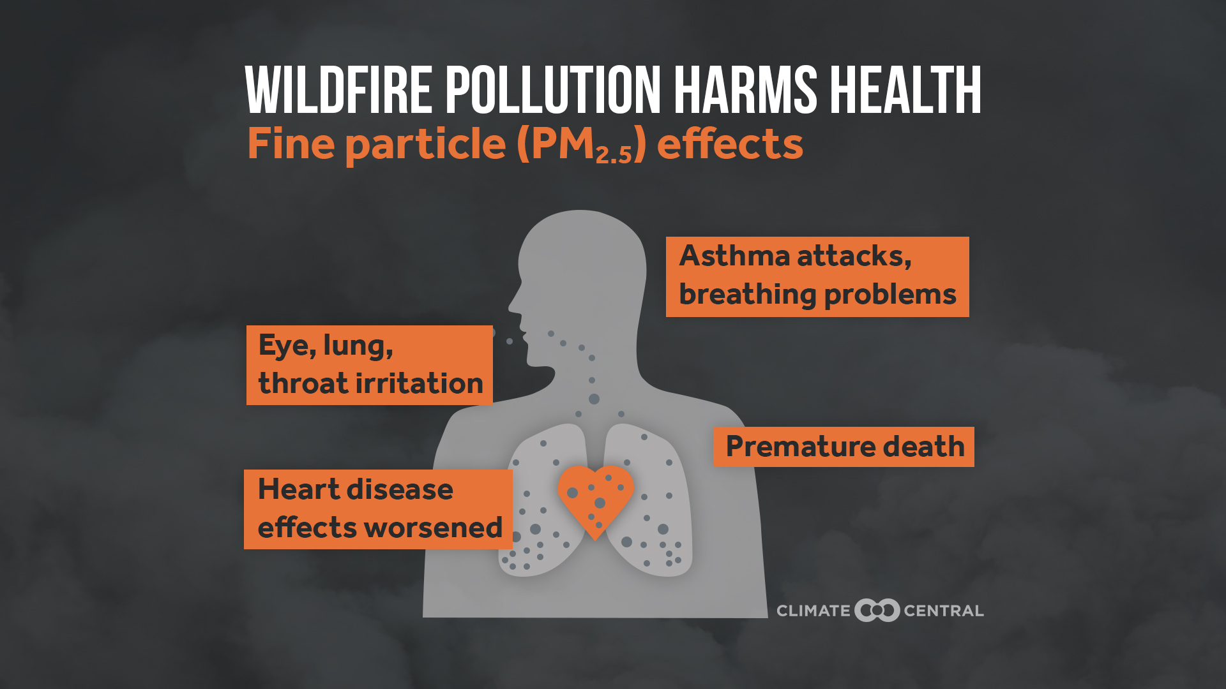
HECC Report – air quality
Increasingly strong evidence base around wildfire smoke and health outcomes
  Studies from USA, Australia etc.
  Lack of UK studies
Respiratory effects
  Hospital admissions for asthma
  GP referrals
  Increased use of medication
Evidence for cardiovascular effects (heart attack, stroke)
Susceptible - young, old, people with pre-existing disease
Evidence consistent with established evidence around air pollution and health

Slide 10
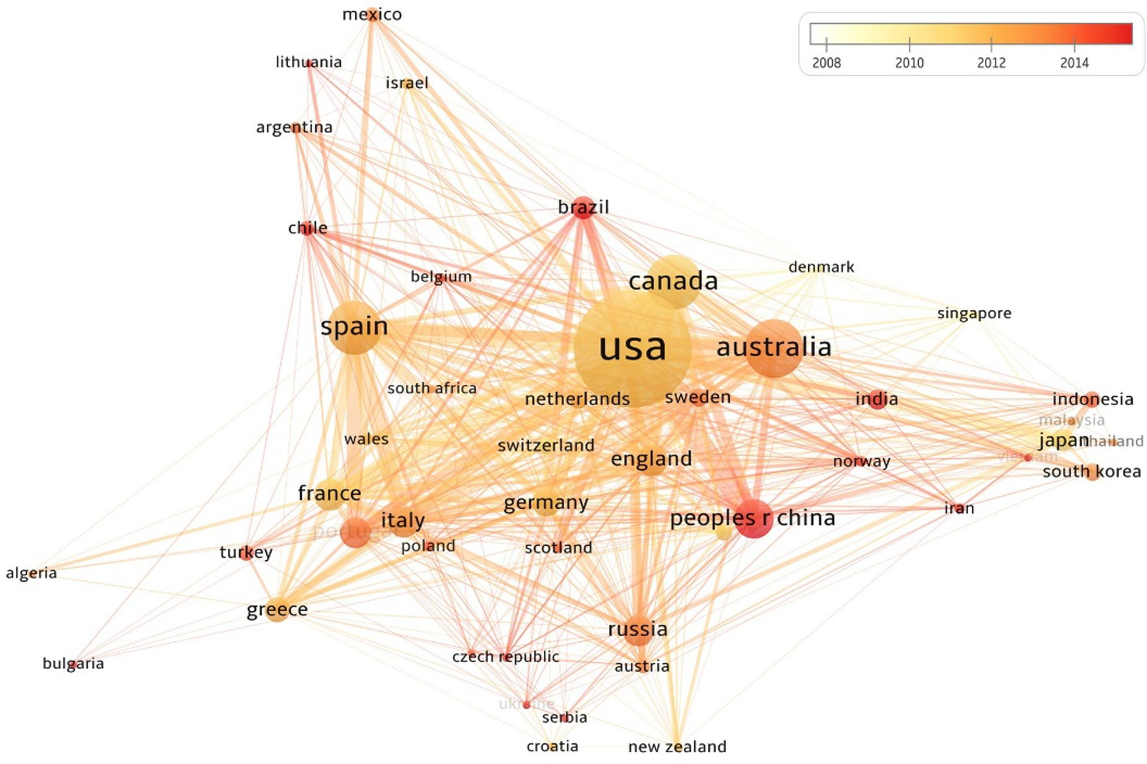
HECC report - Research and knowledge gaps
Strong evidence base from other countries
Limited evidence in UK
Difficult to extrapolate from other countries to the UK
Research priorities
  Smoke composition and emissions
  Improved exposure assessment
    Air monitoring
    Modelling
  Health studies
  Impact on water quality
Haghani et al. Safety Science 2022
https://doi.org/10.1016/j.ssci.2022.105797

Slide 11
Importance of dispersion modelling and environmental monitoring
You can’t manage what you can’t measure
If we don’t know what the air quality impacts are from wildfire smoke, it is very difficult to know exactly:
Who is affected?
When and where?
What levels of harmful pollutants people are breathing in?
How people can reduce their exposure?

Slide 12
Q. Role of dispersion modelling?
In decision making and emergency planning/response during wildfires
  Shelter v evacuation decisions
  Fire-fighting operations
  Controlled / prescribed burning
Supporting public messaging and alerts
Identifying populations at risk
Exposure assessments in health studies
Research into smoke composition, fire / plume behaviour, smoke / air interactions, fuels types etc

Slide 13
Thank you
Contact me: andrew.kibble@ukhsa.gov.uk
chemicalscardiff@ukhsa.gov.uk
Health Effects of Climate Change 2023
https://www.gov.uk/government/publications/climate-change-health-effects-in-the-uk

