Slide 1
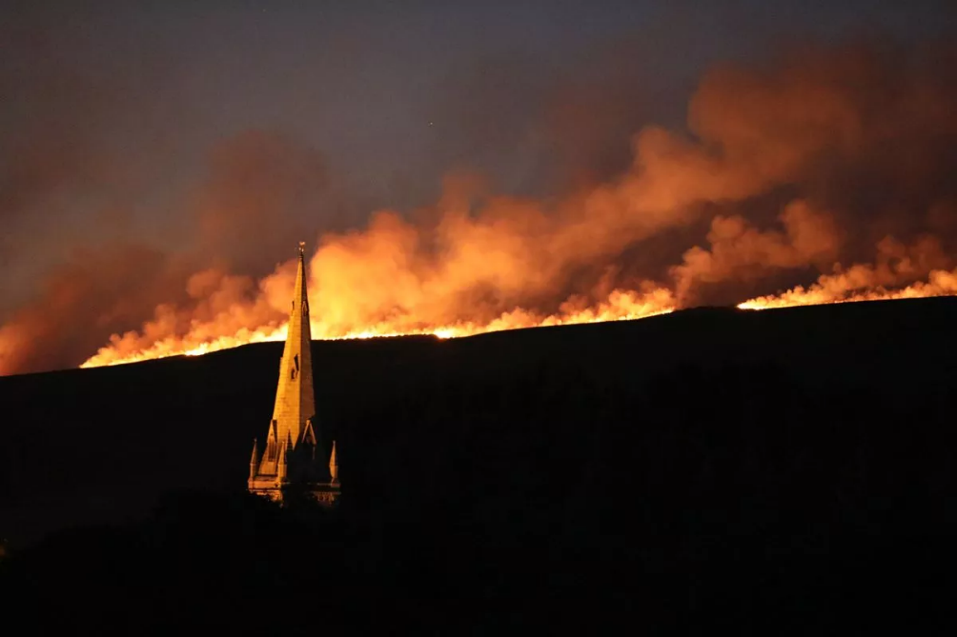
Air quality impacts of the 2018 Saddleworth Moor and Winter Hill fires
Sensitivity to model grid resolution and comparison of Eulerian and Lagrangian transport
Benjamin Drummond¹
benjamin.drummond@metoffice.gov.uk
Ailish Graham^{2,3}
Lucy Neal¹, Pedro Molina-Jimenez¹, Richard Pope^{2,3}, Carly Reddington²
¹Atmospheric Dispersion and Air Quality, Met Office, UK
²School of Earth and Environment, University of Leeds, UK
³National Centre for Earth Observation, University of Leeds, UK
The Winter Hill fire. Credit: Ashley Stocks

Slide 2
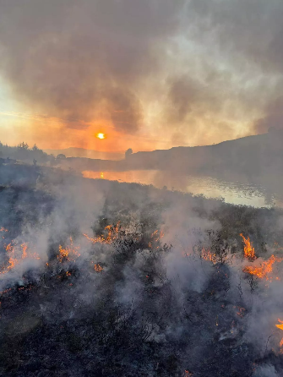
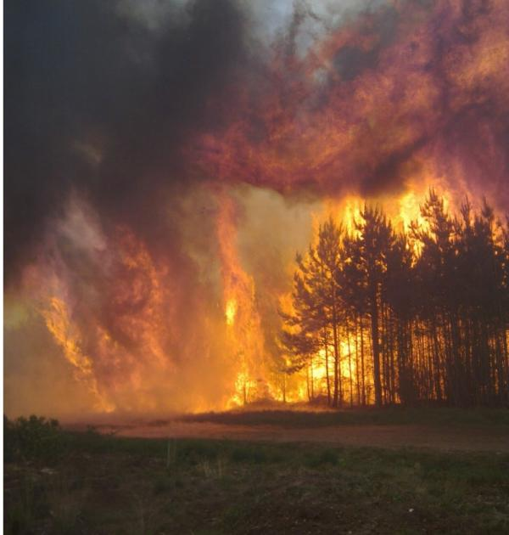
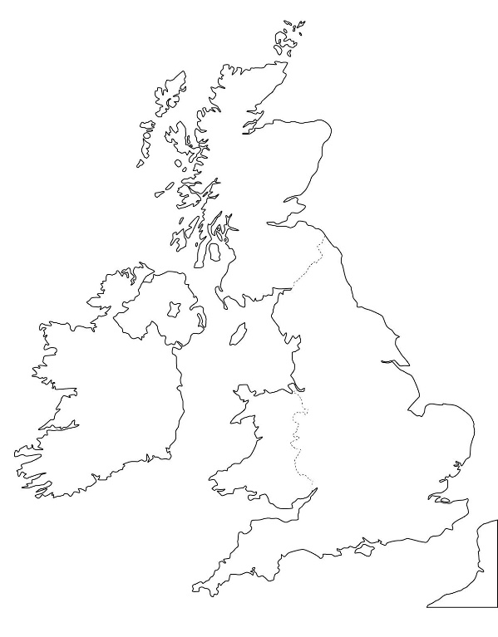

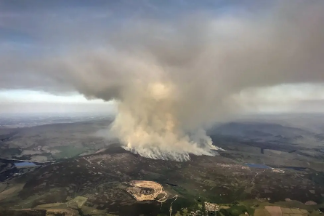
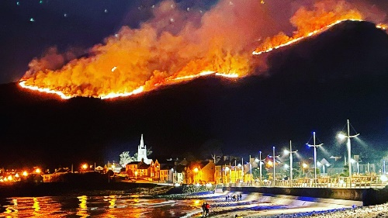
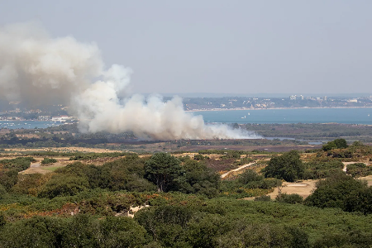
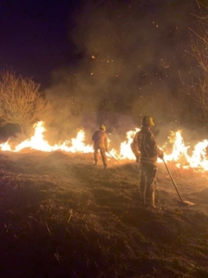
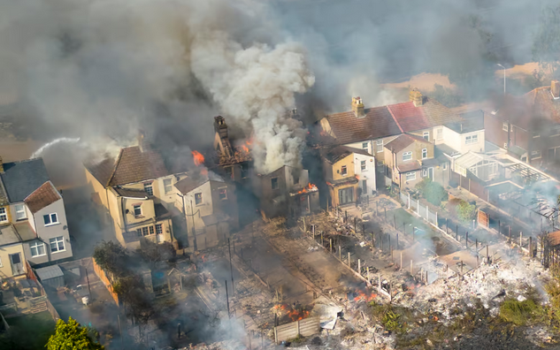
Cannich, N Scotland
May 2023
15 km² (1500 ha)
Scrub and woodland
30+ firefighters, 9+ appliances
Saddleworth Moor and Winter Hill
June-July 2018
Rob Gazzard
Swinley Forest, Berkshire
May 2011
300 ha
300 firefighters, 50 fire appliances
Fort Augustus Fire Station
@DeeJayDready/PA
SWNS
Mourne Mountains, NI
April 2021
300 ha gorse and mountain terrain
60 firefighters, 12 appliances
Brian Dorey
Studland, Dorset
August 2022
5 ha of heathland
90 firefighters
Barbeque/campfire ignition
South Wales
April - June 2023
SWFRS attend ~400 grass and wildfires
Greater London
July 2022
59 separate grass fires in one day
41 properties including homes destroyed
Record breaking UK temperatures
Bradley Page
Garan Thomas
Brian Dorey
See Belcher et al 2021 for more details of some of these and other events
Notes:
https://www.fbu.org.uk/publications/scorched-firefighters-and-resilience-wildfires
https://www.firescotland.gov.uk/news/cannich-wildfire-update/
https://en.wikipedia.org/wiki/Cannich_wildfire
https://www.virtual-swanage.co.uk/gallery/2324/large-heath-fire-near-littlesea-studland
https://www.dwfire.org.uk/news/access-to-and-from-studland-affected-by-heath-fire/
https://www.fbu.org.uk/magazine/august-september-2023/london-july-2022-2496-emergency-calls-control-39-appliances-run-due
https://cdn.forestresearch.gov.uk/2022/05/UKFSPG026_CS6_Swinley.pdf
https://www.nationaltrust.org.uk/visit/northern-ireland/the-mournes/our-work-to-recover-from-the-fires-in-the-mournes
https://www.bbc.co.uk/news/articles/c4n4zjmzpego

Slide 3
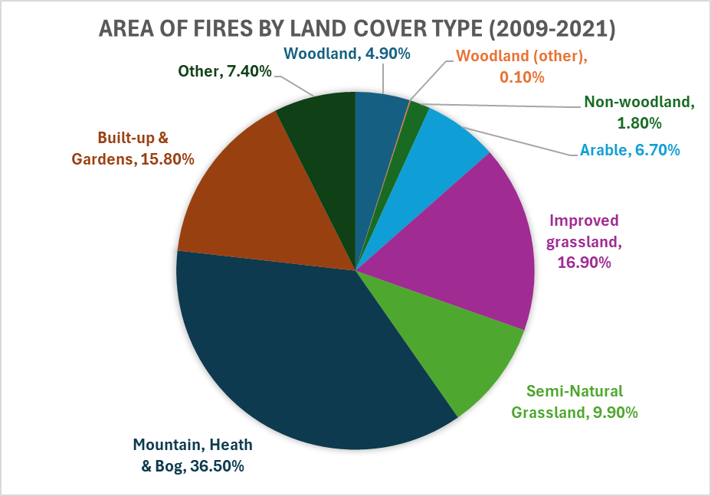
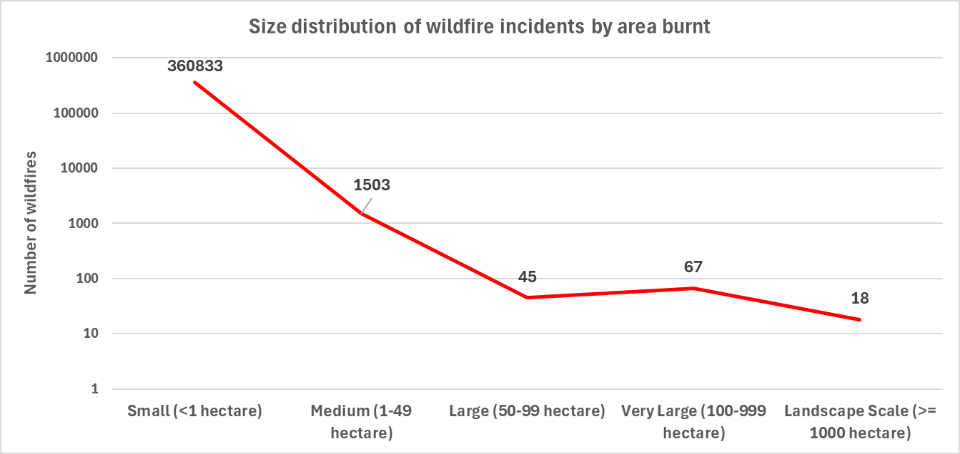
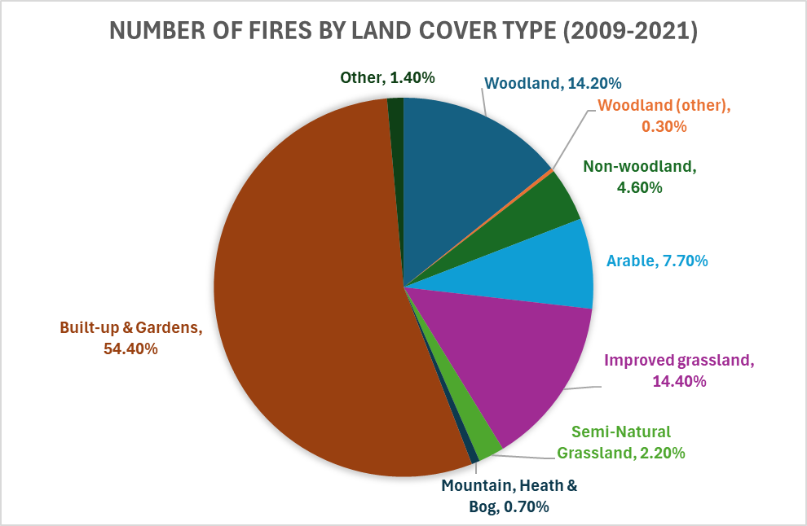
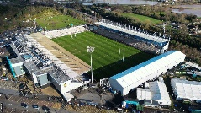

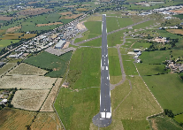
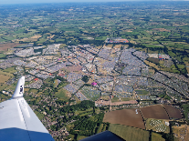
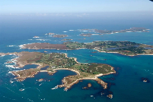
Wildfire statistics for England
Data source: Forestry Commission
2009-2021
1 ha
Sandy Park
Rugby Pitch
12 ha
Eden Project
(biomes & gardens)
75 ha
Exeter Airport
350 ha
Glastonbury
Festival
1600 ha
Isles of Scilly
(land area)
“Fires often occur at the ‘rural-urban interface’, where countryside meets settlements. There are no true wilderness landscapes [in the UK]” – Gazzard et al 2016

Slide 4
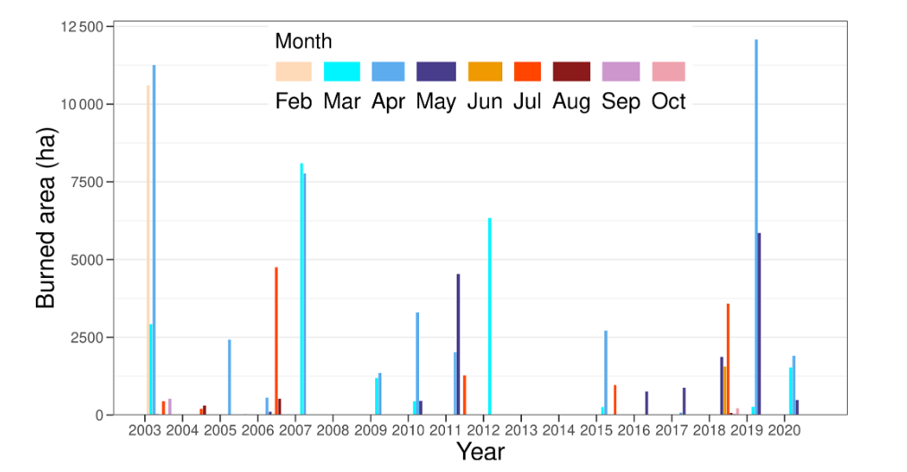
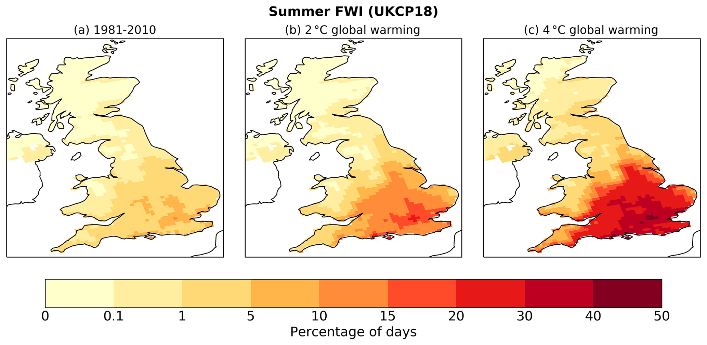
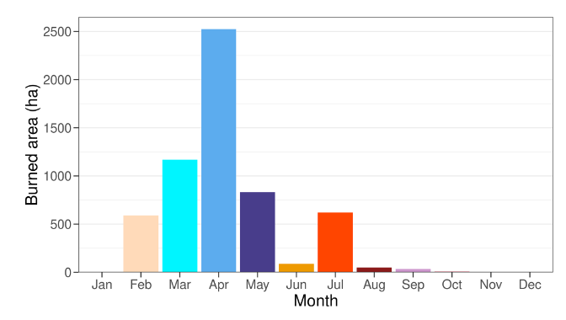
Perry et al 2022
Historical satellite measurements of burned area showed “lack of a significant trend despite some large events occurring in the last few years”
Satellite observed monthly burned area 2003-2020
Fire danger is expected to increase, particularly in summer and autumn, due to climate change, extending the fire season
Satellite observed monthly-mean burned area 2003-2020
% of days with very high fire danger
Similar findings: Arnell et al 2021

Slide 5
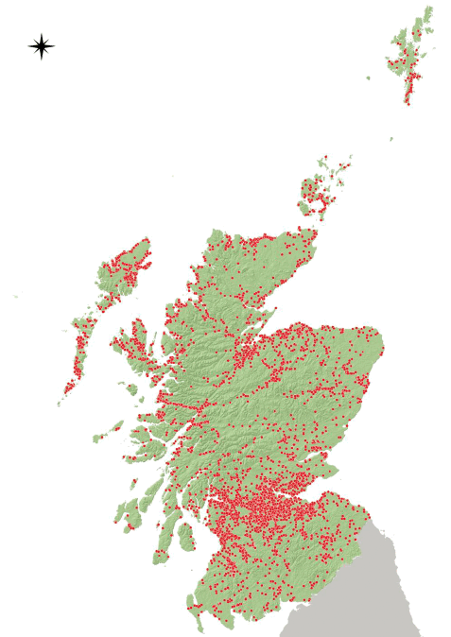
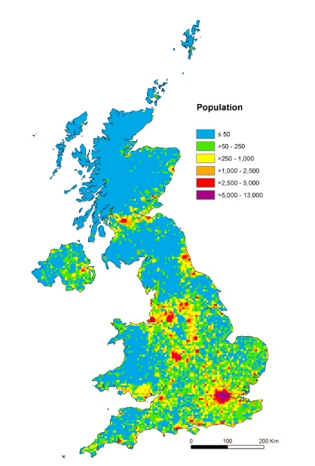
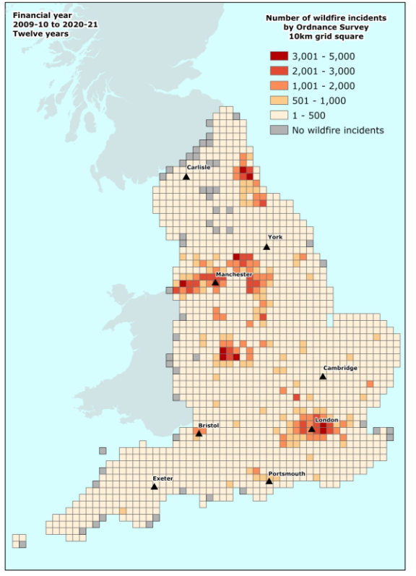
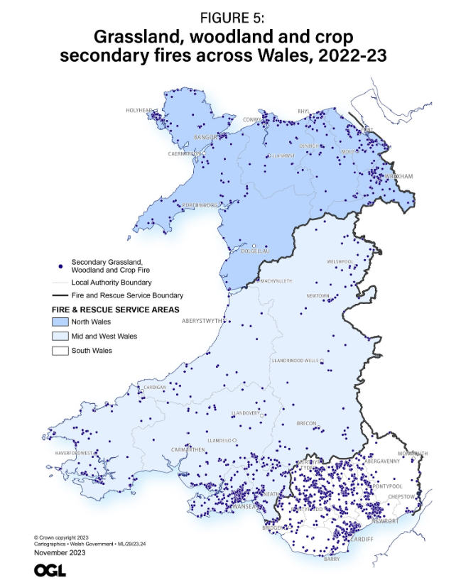
Forestry Commission
Number of wildfire incidents per OS 10 km square
Welsh Government
Scottish Government
Locations of fires identified as wildfires from the SFRS Incident Reporting System
Population density
Vieno et al 2015
“Nearly all UK wildfire ignitions are anthropogenic” – Belcher et al 2021

Slide 6
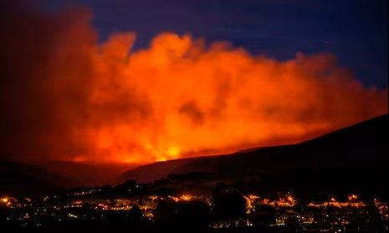
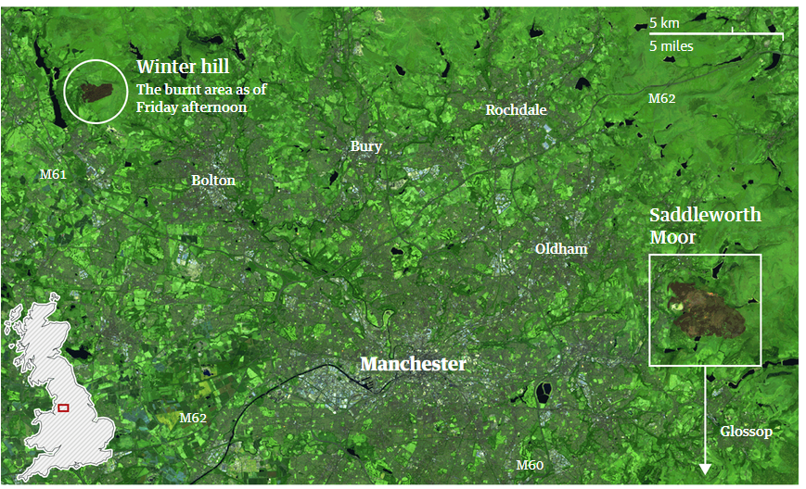
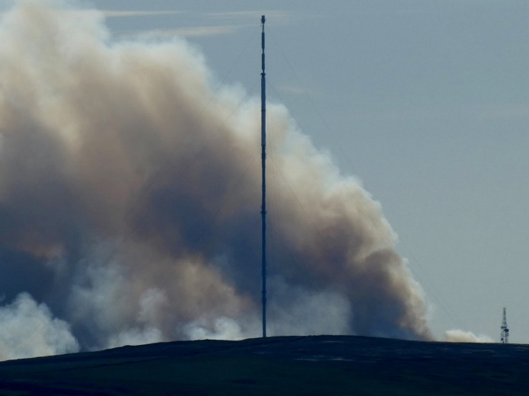
>3 weeks (peak impacts over a few days)
~11 km² moorland burnt (landscape scale)
57 fire engines & 220 firefighters
34 homes evacuated
schools closed
advice to keep windows and doors closed
(Greater Manchester Fire
and Rescue Service, 2021)
Saddleworth Moor and Winter Hill
June - July 2018
Saddleworth Moor fire over Stalybridge. Triangle News.
Guardian graphic. Source: Sentinel-2 imagery
Winter Hill fire with TV mast. Phillip Platt.
Notes:
https://www.lancs.live/news/lancashire-news/gallery/devastation-winter-hill-fire-no-2428659
https://www.manchestereveningnews.co.uk/news/greater-manchester-news/gallery/incredible-pictures-show-what-happened-14851214
https://www.bbc.co.uk/news/uk-england-lancashire-44742632
Winter Hill – 30 km from Manchester City Centre north west
Saddleworth Moor – 20 km east of Manchester city centre

Slide 7
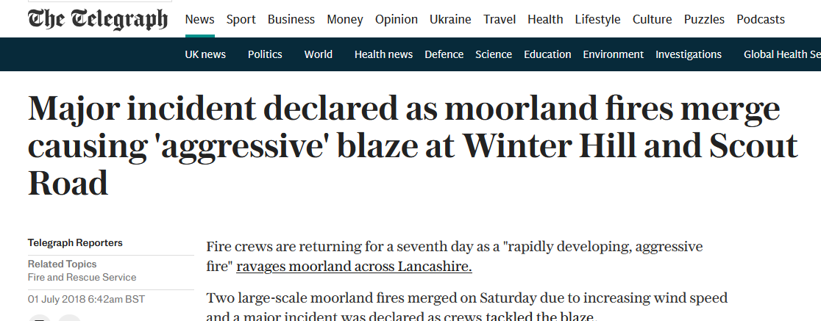
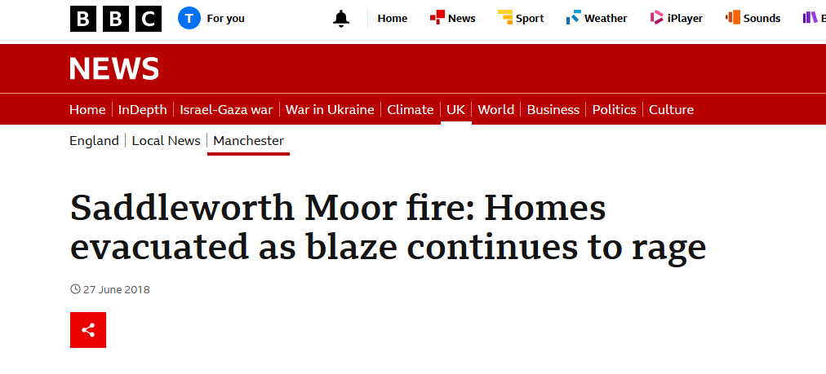
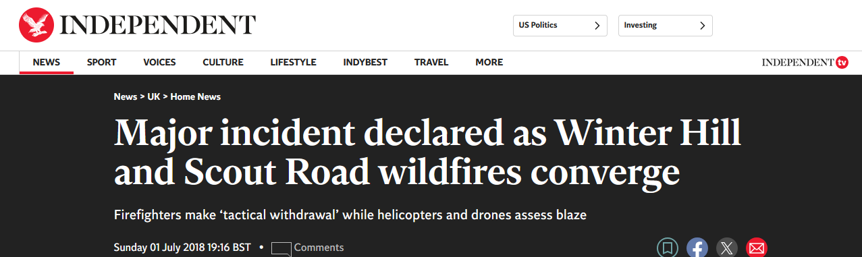
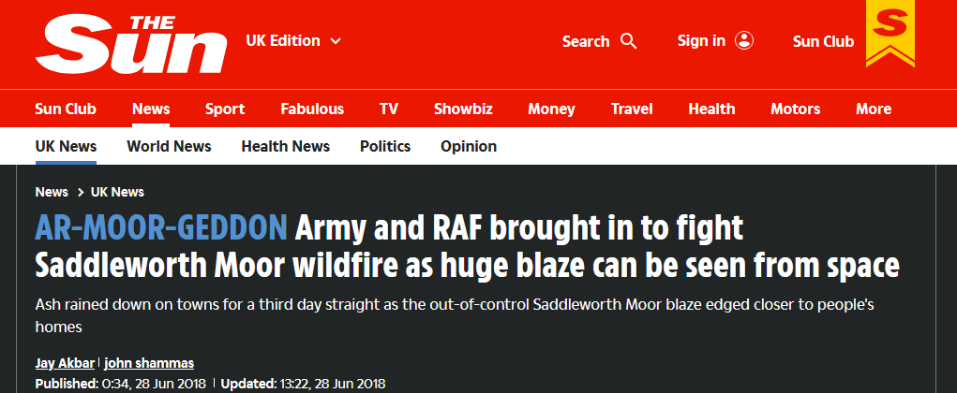
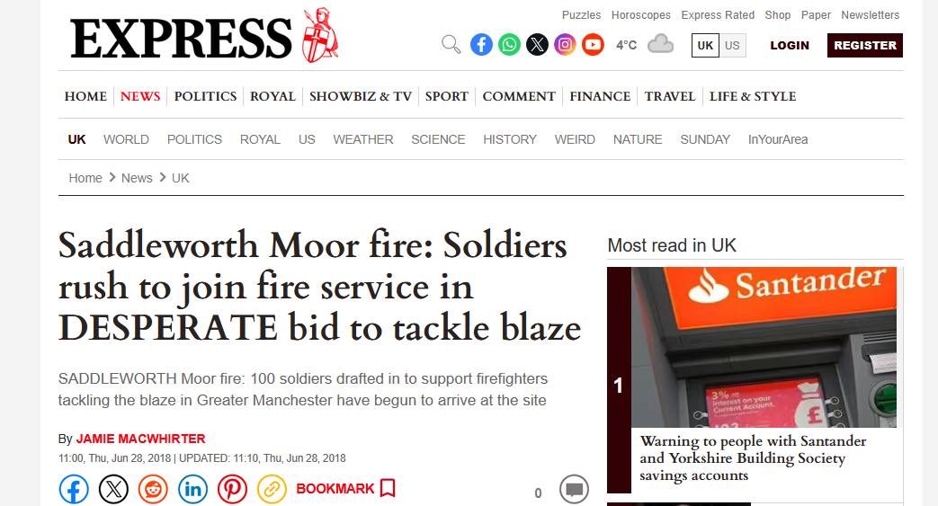
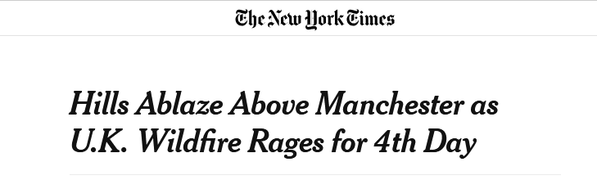

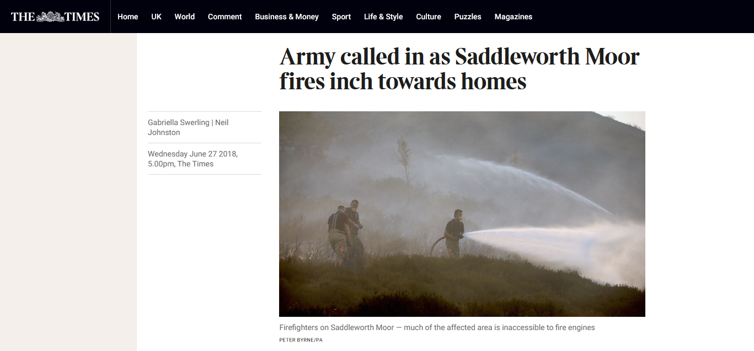


Slide 8
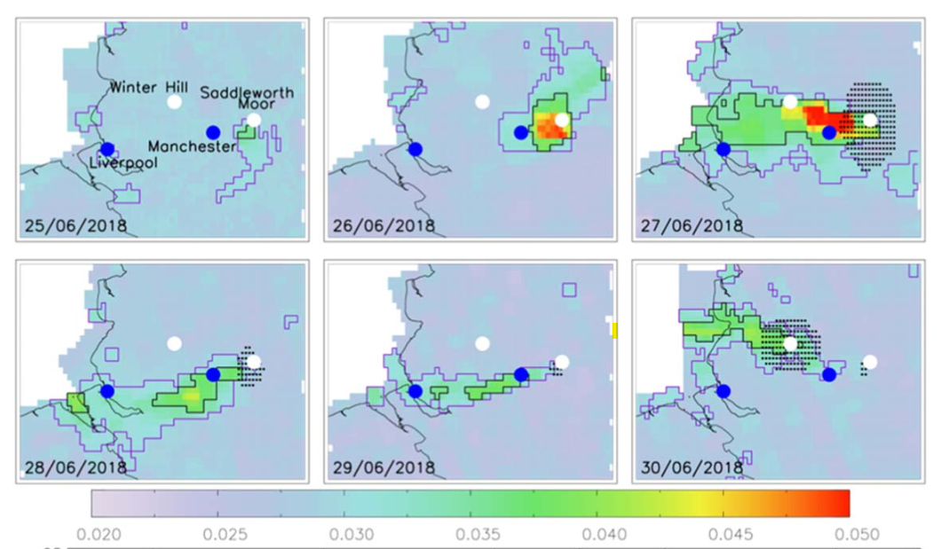
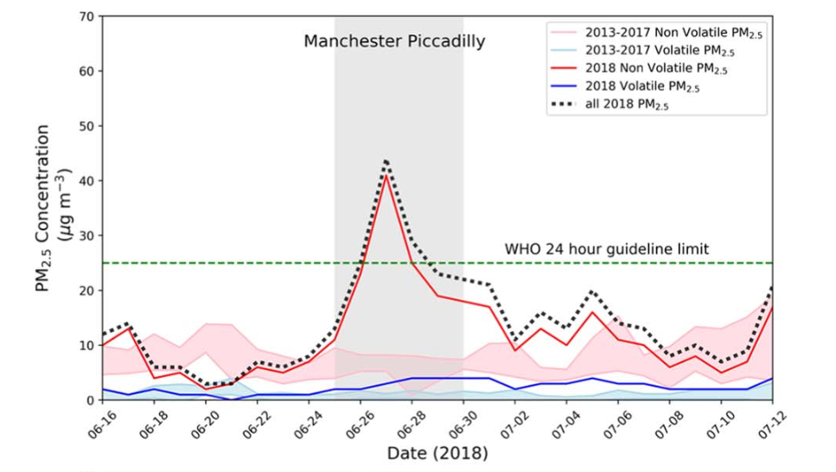
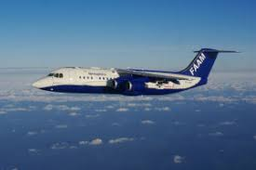
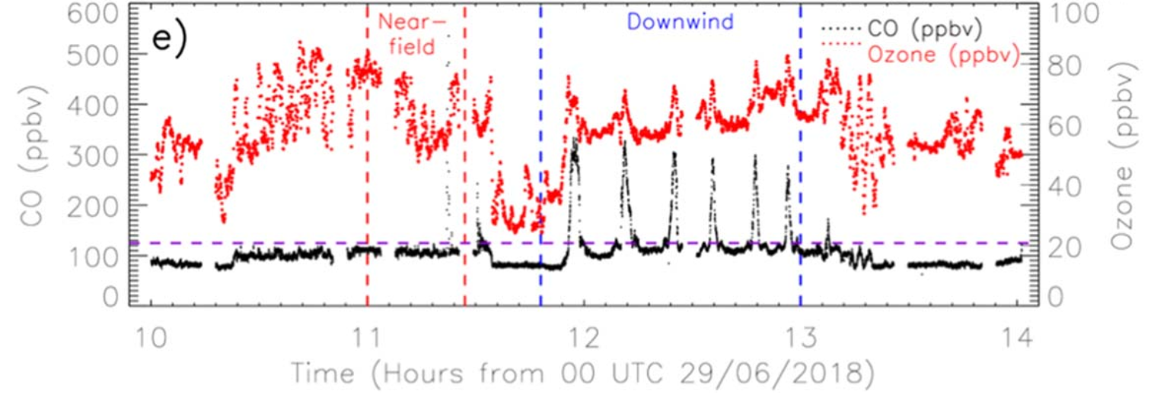
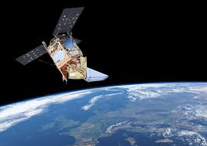
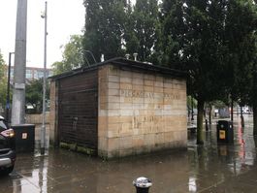
Saddleworth Moor fire pollution measured from the ground, sky and space
Graham et al 2020, ERC
*Now 15 μg m⁻³
Manchester Piccadilly AQ measurement site
PM_{2.5} daily-mean concentration
TCCO, moles m⁻²
FAAM aircraft measured CO and O₃ mixing ratios (29th June)
TROPOMI total column carbon monoxide (CO)

Slide 9
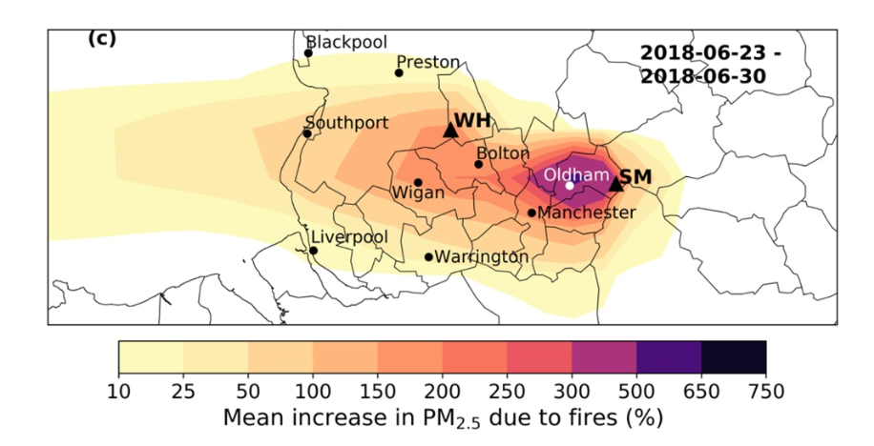
Air quality impacts of the Saddleworth Moor fire
Graham et al 2020, ERL
10 km WRF-Chem simulations
Satellite-derived wildfire emissions inventory
PM_{2.5} concentrations increased by 300%

Slide 10
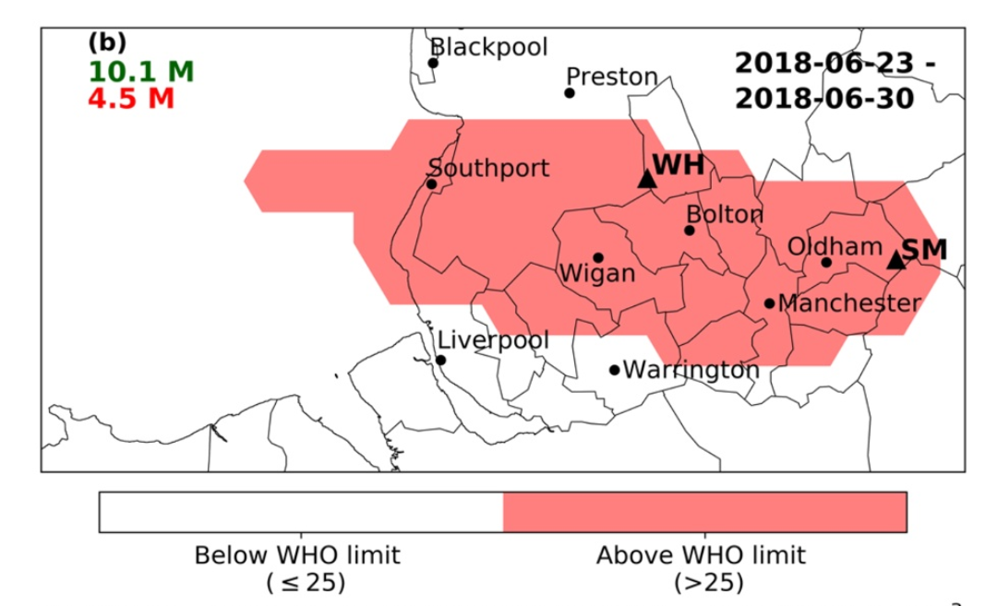
Air quality impacts of the Saddleworth Moor fire
Graham et al 2020, ERL
10 km WRF-Chem simulations
Satellite-derived wildfire emissions inventory
PM_{2.5} concentrations increased by 300%
4.5 million exposed to poor air quality due to fires (PM_{2.5} concentration > 25 μg m⁻³)

Slide 11
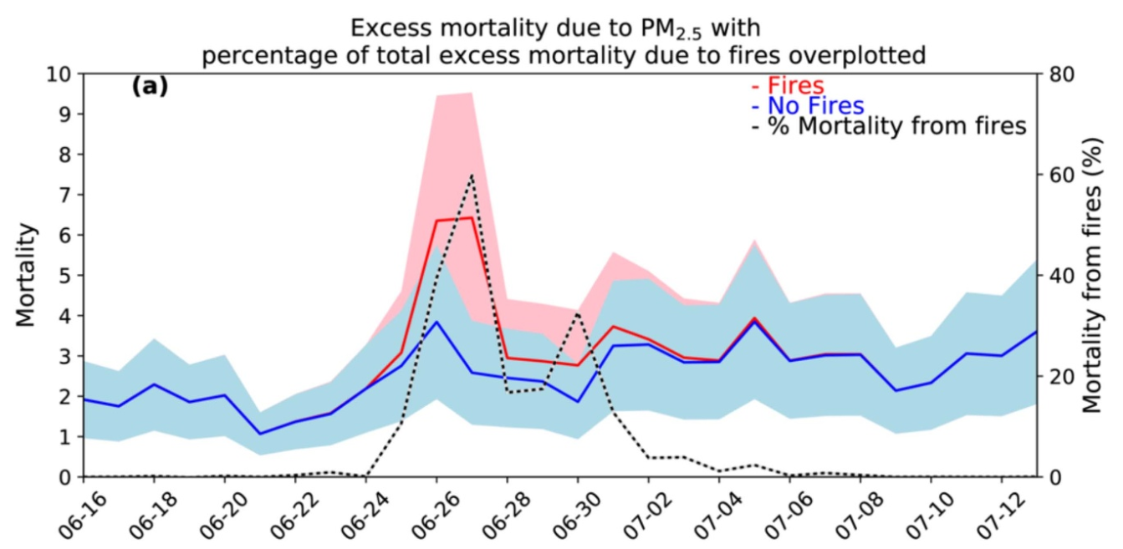
Air quality impacts of the Saddleworth Moor fire
Graham et al 2020, ERL
10 km WRF-Chem simulations
Satellite-derived wildfire emissions inventory
PM_{2.5} concentrations increased by 300%
4.5 million exposed to poor air quality due to fires (PM_{2.5} concentration > 25 μg m⁻³)
Estimated 8.6 excess deaths attributable to fire PM_{2.5} short term exposure
Economic cost of mortality: £21.1 million
“Understanding how people are exposed to smoke from wildfires in the UK is key to any health study and is needed to aid the public health response during a fire.”
UKHSA Health Effects of Climate Change (HECC) in the UK: 2023 report

Slide 12
(Some) Sources of uncertainty
Emissions Estimate
Location; geometry; source strength; composition; temporal evolution; plume-rise or height of emission
Missing and poorly represented physics and chemistry: deposition, chemical evolution, aerosol physics; meteorology-composition feedback; model resolution (spatial and temporal); …
Atm. Dispersion Model
Exposure Estimate
Mobility of individuals; effectiveness of exposure reduction guidance (e.g. closing windows); breathing rate; …
Health Impact Assessment
Varying susceptibility of individuals/populations; multi-pollutant exposure; multi-hazard exposure (e.g. high temperature); …

Slide 13
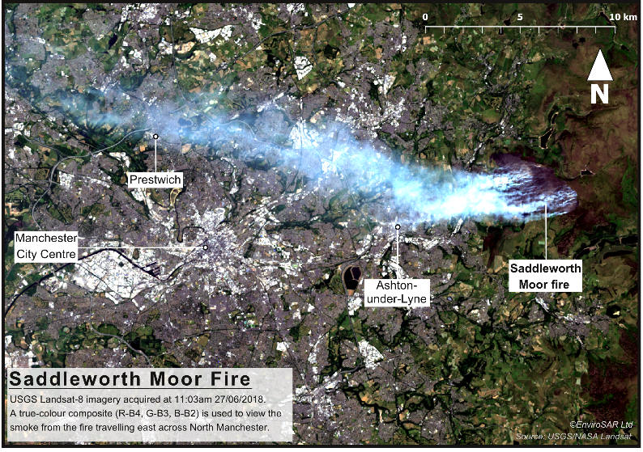
10 km x 10 km
2 km x 2 km
1 km x 1 km

Slide 14









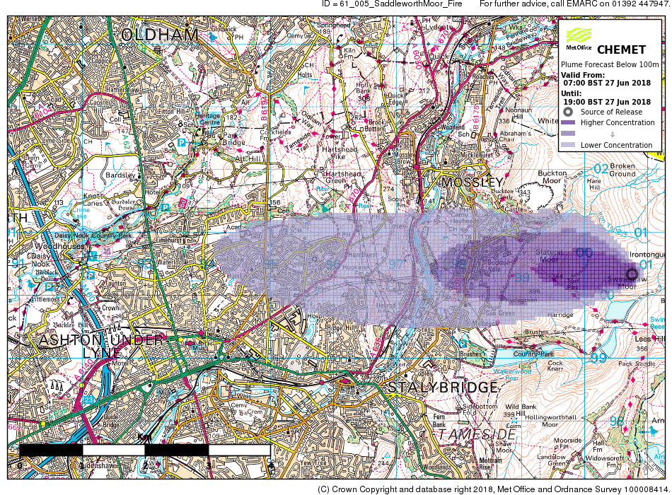

Models the emission, transport, chemical change and deposition of materials released to the atmosphere
Lagrangian particles
Eulerian fields
Output grid
Computational grid
NAME Lagrangian used to produce CHEMET

Slide 15
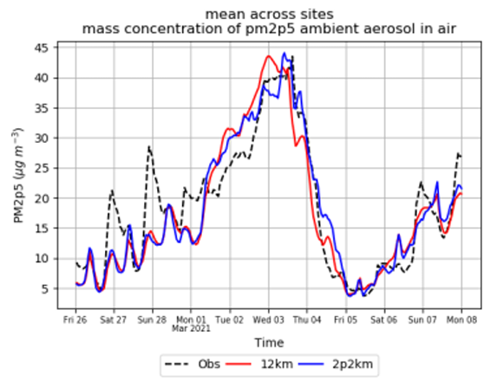
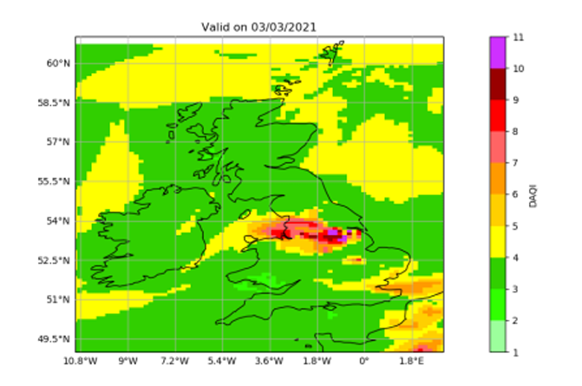
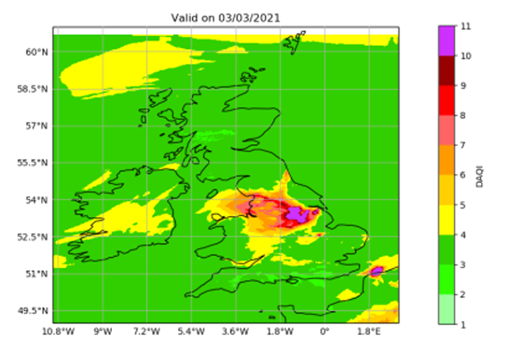
NAME UK air quality configuration
UK and NW Europe domain
Met Office Unified Model NWP
National Atmospheric Emissions Inventory
Tropospheric chemistry and aerosol scheme
Dry and wet deposition
Boundary conditions from ECMWF’s Global forecast model
Eulerian setup
12 km
2.2 km

Slide 16
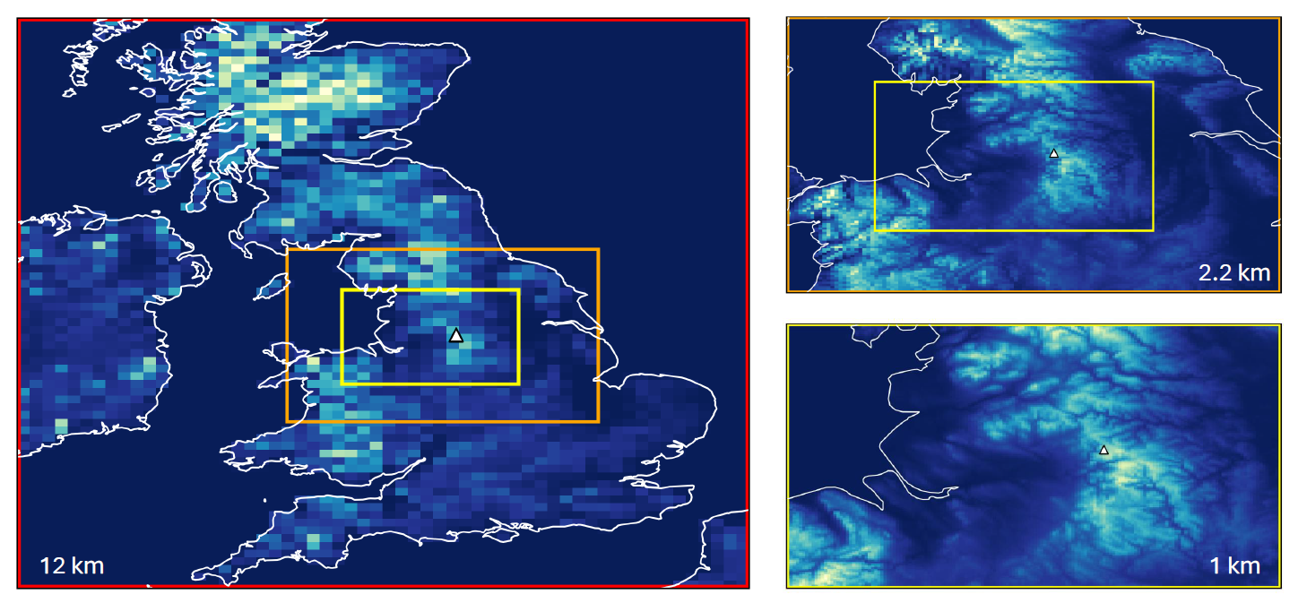
NAME Saddleworth Moor fire experiments
15th June – 10th July 2018
Met Office UK 1.5 km NWP
Added ‘wildfire primary PM_{2.5}’ species
  Represented by Lagrangian particles or Eulerian field
  Chemically inert
  Dry and wet deposited
Three domains used with different horizontal grid resolutions (illustrated by orographic height in blue-yellow colour scale)
Resolution | 12 km | 2.2 km | 1 km
Eulerian | E12 | E2.2 | E1
Lagrangian | L12 | L2.2 | L1

Slide 17
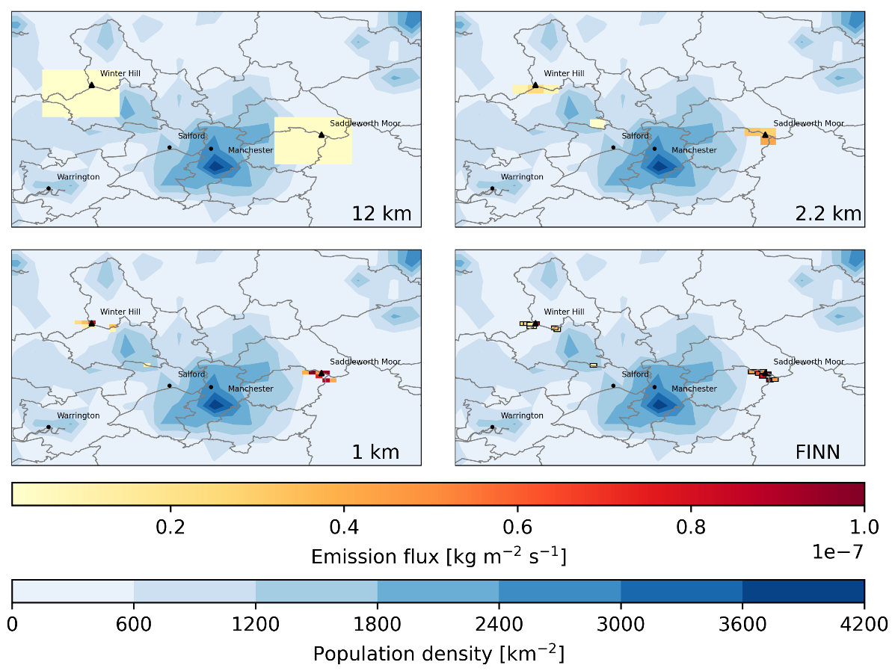
Wildfire primary PM_{2.5} emissions
Fire INventory from NCAR (FINN) v2.5 Wiedinmyer et al (2023)
Daily, 1 km resolution, global
MODIS + VIIRS fire detections
Emitted near to the surface
Eulerian:
  Fire points allocated to nearest model grid cell, bottom two layers (0 - 20 m)
Lagrangian:
  1 km² cuboid source with 20 m depth, centered on fire point
Daily wildfire emissions for 29th June gridded onto 12 km, 2.2 km and 1 km NAME grids, and as individual FINN fire points

Slide 18
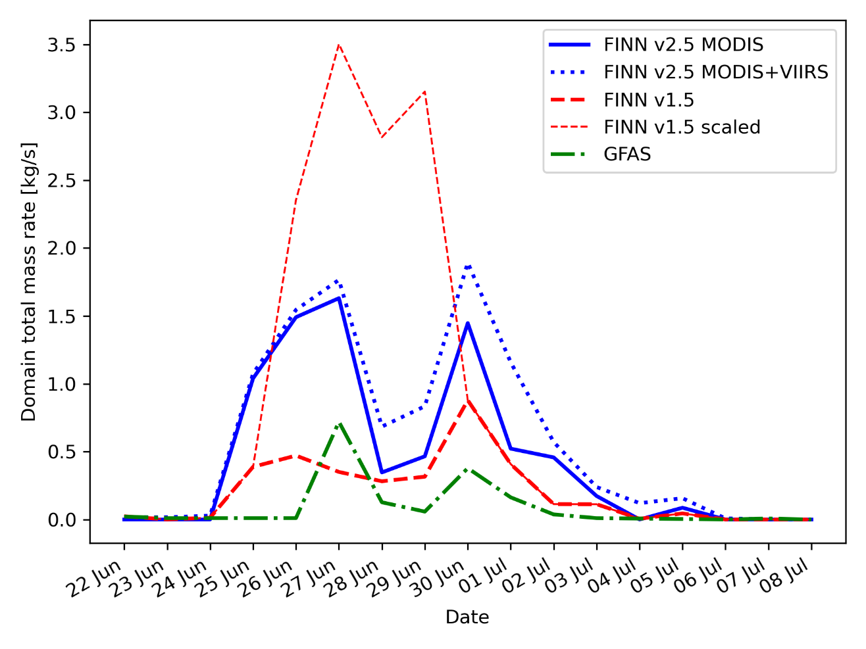
Wildfire primary PM_{2.5} emissions
A climatological diurnal profile is applied to convert daily to hourly emissions (WRAP, 2005)
Graham et al (2020) scaled the FINN v1.5 emissions to increase emissions on some days (thin red dashed line) to improve WRF-Chem agreement with measured concentrations
FINN v2.5 MODIS+VIIRS used in NAME without extra scaling
Timeseries of daily fire emissions for Saddleworth Moor + Winter Hill

Slide 19
Results
Surface concentration maps
Timeseries at some air quality monitor sites
Verification with air quality monitor data
Exposure estimates
Health impact assessment
Submitted to Atmospheric Environment

Slide 20






Eulerian
Lagrangian
Daily-mean
wildfire PM_{2.5}
near-surface concentration
27th June 2018
12 km
2.2 km
1 km

Slide 21






Eulerian
Lagrangian
Daily-mean
wildfire PM_{2.5}
near-surface concentration
29th June 2018
12 km
2.2 km
1 km

Slide 22

PM2.5 concentration [μg m⁻³]
Daily-mean PM_{2.5} concentration at four AURN urban background sites

Slide 23
 | No Fires |  |  | With fires
 | 12 km | 2.2 km | 1 km | E12 | E2.2 | E1 | L12 | L2.2 | L1
Mean concentration [μg m⁻³] | 6.30 | 7.12 | 7.41 | 8.15 | 8.33 | 8.55 | 7.56 | 8.22 | 8.49
Maximum concentration [μg m⁻³] | 9.55 | 13.29 | 11.82 | 57.15 | 43.60 | 45.36 | 35.81 | 42.82 | 42.85
Mean bias [μg m⁻³] | -5.45 | -4.63 | -4.34 | -3.60 | -3.42 | -3.21 | -4.19 | -3.53 | -3.26
RMSE [μg m⁻³] | 8.21 | 7.62 | 7.59 | 5.16 | 4.72 | 4.68 | 5.82 | 4.90 | 4.84
Correlation coefficient, r | 0.34 | 0.39 | 0.27 | 0.83 | 0.88 | 0.87 | 0.80 | 0.87 | 0.85
Verification of daily-mean PM_{2.5} concentration at 12 AURN sites

Slide 24


Population exposure estimate
Model concentrations regridded to a 1 km UK population dataset
Sum the population count over grid cells that exceed threshold on at least one day
WRF-Chem 10km above 25 μg m⁻³
Graham et al 2020
NAME above 15 μg m⁻³

Slide 25


Population exposure estimate
3.47
1.25
2.74
2.52
2.47
2.38
0.66
2.31
0.82
0.74
0.16
0.71
0.66
0.64
0.21
0.16
0.08
0.22
0.17
0.16
0.14
0.16
0.14
0.66
0.51
0.41
0.38
0.28
0.33
Moderate: 35.5 – 53.5 μg m⁻³
High: 53.5 – 70.5 μg m⁻³
Very High: >70.5 μg m⁻³

Slide 26



Health Impact Assessment
$$Em=\sum_{i=1}^{N}{B_{d}p_{i}AF_{i}}$$
Deaths brought forward 23-30 June due to fire PM_{2.5} short-term exposure
Em: excess mortality
B_{d}: baseline mortality rate
p_{i}: Population exposed
AF_{i}: Attributable fraction
AF_{i} calculated using a relative risk value of 1.04%
(95% CI: 0.52%,1.56%) per 10 μg m⁻³ increase in PM_{2.5} for all-cause, all-age mortality
Atkinson et al 2014
10 km WRF-Chem Eulerian = 8.6
Graham et al 2020

Slide 27
Summary of results
12 km NAME Eulerian results broadly in good agreement with previous estimates using 10 km WRF-Chem Eulerian model (Graham et al 2020)
Estimates are sensitive to model resolution, particularly for Eulerian
  Population exposed to fire PM_{2.5} > 15 μg m⁻³ decreased a third (E12 → E1)
  Population exposed to “Very High” PM_{2.5} decreased by two thirds (E12 → E1)
  Estimates deaths brought forward decreased by a third (E12 → E1)
Estimates of air quality impacts from NAME simulations:
  2.3 - 3.5 million affected by poor air quality due to fires (above WHO guideline)
  0.16 – 0.66 million experienced “Very High” PM_{2.5} daily-mean concentration
  5 – 8 deaths estimated brought forward due to short-term exposure to fire PM_{2.5}

Slide 28
Limitations of this work
Very simple representation of vertical release (plume-rise) and sub-daily temporal variation of emissions
Did not consider in-plume chemistry or aerosol processes
Only considered single pollutant (PM_{2.5}), didn’t consider other climate aspects (e.g. heat)
Population exposure estimate based on 1 km residential population count
Outdoor pollution levels only – infiltration of smoke indoors, effectiveness of sheltering advice
Daily-mean PM_{2.5} concentrations – peak concentrations may be much higher
…

Slide 29
Wildfires are a growing concern in the UK
Impact of wildfire smoke on air quality in the UK is not well studied (HECC, 2023)
Dispersion modelling is a key tool
  for estimating health and environmental impacts of wildfire smoke
  during emergency response
We can learn from other nations and regions – but we also need to do more to understand wildfire smoke in the UK context
(Belcher et al 2021)
Thank you for your attention

Slide 30
References
Arnell et al 2021: Environ. Res. Commun. 3 095005
Belcher et al 2021: UK Wildfires and their Climate Challenges
Gazzard et al 2016: https://doi.org/10.1098/rstb.2015.0341
Graham et al, ERL, 2020: Environ. Res. Lett. 15 074018
Graham et al, ERC, 2020: Environ. Res. Commun. 2 031001
Greater Manchester Fire and Rescue Service, 2021: https://manchesterfire.gov.uk/media/2391/21-0122-gmfrs-fire-plan-2021-web.pdf
HECC 2023: https://assets.publishing.service.gov.uk/media/65705b7a7391350013b03bbc/HECC-report-2023-chapter-10-wildfires.pdf
Perry et al 2022: https://doi.org/10.5194/nhess-22-559-2022
Wiedinmyer et al 2023: https://doi.org/10.5194/gmd-16-3873-2023

