Slide 1
FUVN introduction, EHE update
ADMLC Summer Meeting 19/07/24
Silvia Garelli

Slide 2
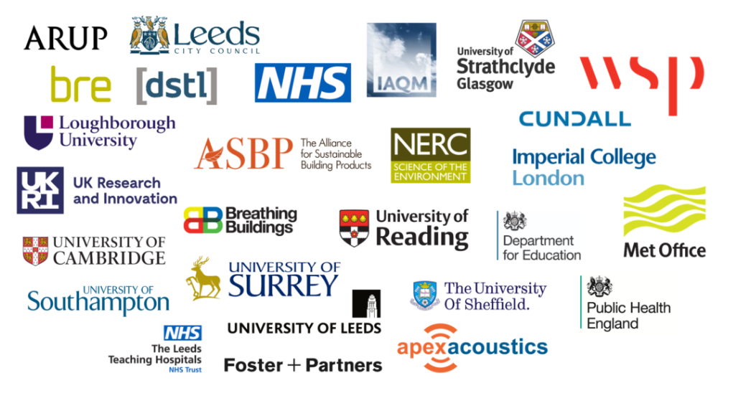
FUVN: aim
FUVN (Future Urban Ventilation Network) is a UKRI funded research network, under the 2020 SPF Clean Air Programme, that brings together researchers and practitioners across the UK to develop a new “Breathing City” methodology to manage exposure to air pollution by considering the airflows between indoor and outdoor environments – ending soon, July 2024- Breathing City – Future Urban Ventilation Network
  focus on the physics of the indoor-outdoor exchange
  develop innovative new solutions to tackle current and future air quality challenges
  Partners:

Slide 3
FUVN: output
Open Repository of latest available datasets, contains information from field experiments, laboratory and modelling, CFD studies. breathingcity.org (google.com)
Seminars Events – Breathing City
They will publish a position statement paper on the coupling of indoor and outdoor environments. Launch event at Imperial College (5th July 2024) Coupled indoor-outdoor environments for better indoor air quality – Breathing City) - we will send link to paper when published

Slide 4
EHE Update
BRE project (2016): data from wind tunnel experiments aimed at investigating ingress from neutrally and positively buoyant releases (describing fires). We will look how the data can be used to inform or support work/research. We would be interested to speak with wind tunnel specialists to know how the data could be organised/presented to make them relevant and useful to other groups.

