Slide 1
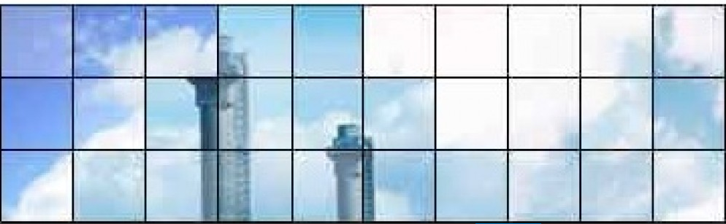

Atmospheric Dispersion Modelling Liaison Committee (ADMLC)
Investigating the impact of applying different grid resolutions of NWP data in atmospheric dispersion modelling
UKHSA, Harwell, UK
Friday 18 October 2024
Simon Gant (ADMLC Chair, Health and Safety Executive)
© Crown Copyright, 2023

Slide 2
Safety and Local Information
Centre for Radiation, Chemical and Environmental Hazards

Slide 3
IF YOU HEAR AN ALARM YOU MUST TAKE IMMEDIATE ACTION
FIRE ALARM | A Warbling Sound – Leave the building and follow the signs to the assembly point at the front of the Training Centre
SITE INCIDENT ALARM | An intermittent noise from the klaxons like harsh car hooters. This requires no action from our building occupants
CAR PARKING | All vehicles are parked at owners risk. Normal precautions should be taken against loss or theft. Your vehicle registration number should be logged with Reception
BADGES | Badges should be worn at all times and returned to Reception when you leave
© Crown Copyright

Slide 4
The Chilton Training Centre
Syndicate rooms
Office
5
6
7
Lecture Theatre
Tea, coffee and
Lunch
Syndicate
room
9
Toilets
J BLOCK
Emergency Exits
Muster points
Link
© Crown Copyright

Slide 5
Supplementary Information For Visitors
PLEASE TURN OFF ALL MOBILE PHONES & PAGERS
Messages can be left with Reception - 01235 825313. Messages for you will be pinned on the board adjacent to the servery
PLEASE NOTIFY RECEPTION BEFORE LEAVING (even temporarily)
In the event of an emergency we need to know who is still in attendance
PLEASE DO NOT BRING FOOD OR DRINK INTO THE LECTURE THEATRE
This is for cleaning & hygiene reasons
SMOKING IS NOT PERMITTED ON PHE PROPERTY
PLEASE NOTE, NO PHOTOGRAPHY IS ALLOWED ON THE PREMISES

Slide 6
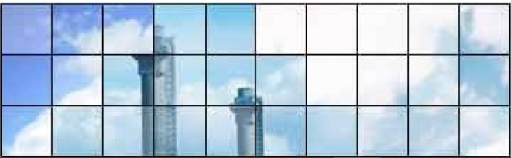













ADMLC Membership

Slide 7
ADMLC Recent Work
January 2021: “Guidelines for the Preparation of Short Range Dispersion Modelling Assessments for Compliance with Regulatory Requirements” – An Update to the ADMLC 2004 Guidance https://admlc.com/model-guidelines/
July 2021: Report published on “Dense-gas dispersion for industrial regulation and emergency response” by Rachel Batt (HSE)
  Spreadsheet of datasets for model validation
  Spreadsheet of previous incidents
  https://admlc.com/publications/
September 2021: Report published on “A Review of Approaches to Dispersion Modelling of Odour Emissions and Intercomparison of Models and Odour Nuisance Assessment Criteria” by CERC and ELLE https://admlc.com/publications/

Slide 8
ADMLC Ongoing Work
Review of methods used to assess the performance of atmospheric dispersion models
Scope:
  Literature review
  Case studies
  Guidance on application of model evaluation methods to different scenarios
Contract awarded to CERC and Steven Hanna
Timeline: results to be presented in 2025
Ron Meris (DTRA) kindly offered to provide external peer review
ADMLC welcomes partnerships with other funding agencies or self-funding research organisations on topics of mutual interest

Slide 9
ADMLC Future Work?
Impact of changing meteorology (due to global warming) on dispersion model predictions
Design of sensor networks to inform dispersion modelling
Further ideas welcome

Slide 10
ADMLC Website Updates
H1 Tool https://admlc.com/h1-tool/
  H1 (formerly D1) was the Environment Agency’s software tool to calculate the stack height for satisfactory dispersion of various substances
  Withdrawn in 2016 and not Environment Agency current guidance
  Still a useful method for calculating effective stack heights
Safety and Reliability Directorate (SRD) Reports
  Historical reports produced by SRD (UK Atomic Energy Authority)
  Examples:
    The accidental release of anhydrous ammonia to the atmosphere – a systematic study of factors influencing cloud density and dispersion.
    Discharge rate calculation methods for use in plant safety assessments.
  https://admlc.com/safety-and-reliability-directorate-srd-series-reports/
Hosting datasets
  Jack Rabbit III and MODISAFE

Slide 11
ADMLC Webinars and Seminars
May 2021: “Dispersion modelling and satellites” webinar
February 2022: “Use of dispersion modelling for sensor network design to facilitate source attribution, emissions estimation and incident response” webinar
March 2023: “Dense gas dispersion modelling in complex terrain, with a focus on carbon dioxide pipelines” webinar
October 2023: “Dry deposition and surface chemical reactivity” seminar
December 2023: “Modelling katabatic flows” webinar
February 2025: “Modelling wildfires” seminar, Met Office, Exeter
Recordings available: http://www.admlc.com/events

Slide 12
Impact of different resolutions of NWP data
Motivation
NWP data is becoming more widely used as an input to dispersion modelling for
  Regulatory air quality impact assessments
  Probabilistic accident consequence assessments of radiological releases
Resolution of NWP data can affect
  Representativeness of meteorology
  Influence of localized effects: terrain, land/sea breezes etc.
How does the NWP resolution affect dispersion model predictions?
  Is there an issue with double-counting of terrain effects with some dispersion models?
Meeting aims: CERC and UKHSA to present detailed findings
  Opportunity for consultants and regulators to discuss how the results should be used to inform future work

Slide 13
Seminar Programme
10:00 | Simon Gant (HSE) | ADMLC Chair’s welcome
10:10 | James O’Neill (CERC) | Findings of CERC study
11:10 | Peter Bedwell (UKHSA) | Findings of UKHSA study
11:30 | Coffee/tea break
12:00 | Kieran Laxen (IAQM, APS) | New IAQM guidelines & application of met data
12:15 | Matthew Bevington (NRW) | Regulator’s perspective
12:30 | Discussion
12:00 | Lunch

Slide 15
Thank you
Investigating the impact of applying different grid resolutions of NWP data in atmospheric dispersion modelling
Speakers:
  James O’Neill (CERC)
  Peter Bedwell (UKHSA)
  Keiran Laxen (IAQM, APS)
  Matthew Bevington (NRW)
ADMLC Secretariat for organising and hosting the meeting
  Justin Smith, Peter Bedwell and Claire Delides (UKHSA)
Thanks also to all contributors for useful discussions

Slide 16
Thank you
We would welcome feedback: admlc@ukhsa.gov.uk
  What worked well?
  What could we improve?
  Future ideas for ADMLC webinars and seminars?

